Slide 1
Chapter 16 Waves in One Dimension

Slide 2
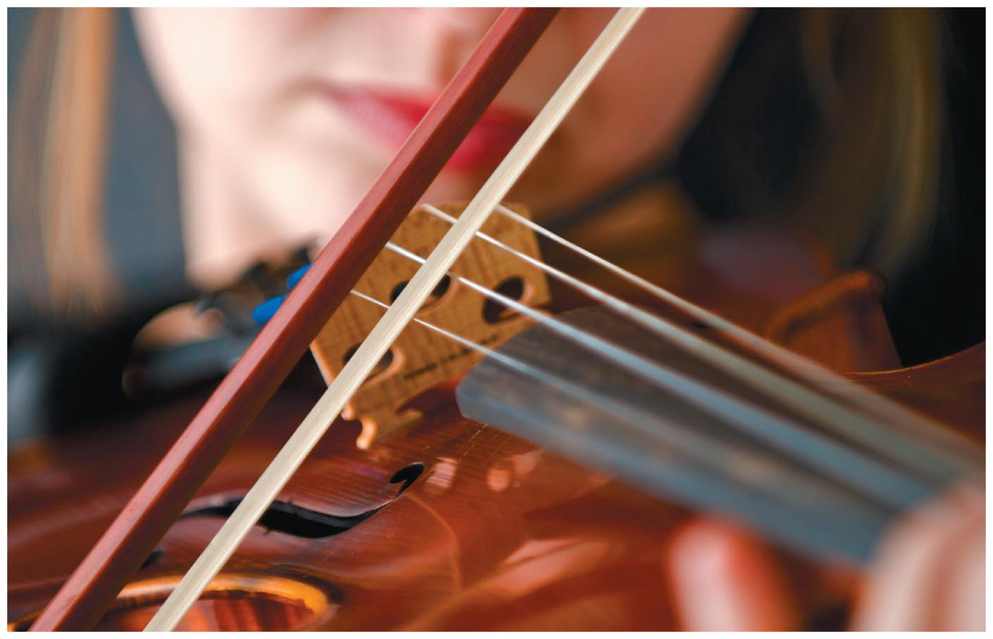
Chapter 16: Waves in One Dimension
Chapter Goal: To study the kinematic and dynamics of wave motion, i.e., the transport of energy through a disturbance propagating through matter or empty space.

Slide 3
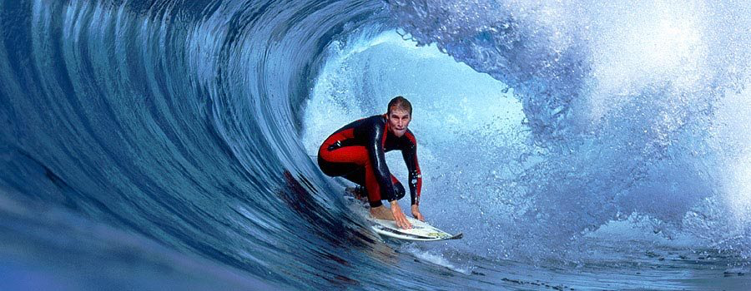
Chapter 16 Preview
Looking Ahead: Representing waves
Waves are common in our surroundings and can be seen in water, heard via sound, and travel as light through space.
https://www.youtube.com/watch?v=H0K2dvB-7WY
https://www.youtube.com/watch?v=dsrUxhaaWks
https://vimeo.com/83187924
https://www.youtube.com/watch?v=LkYDs-q50mY

Slide 4
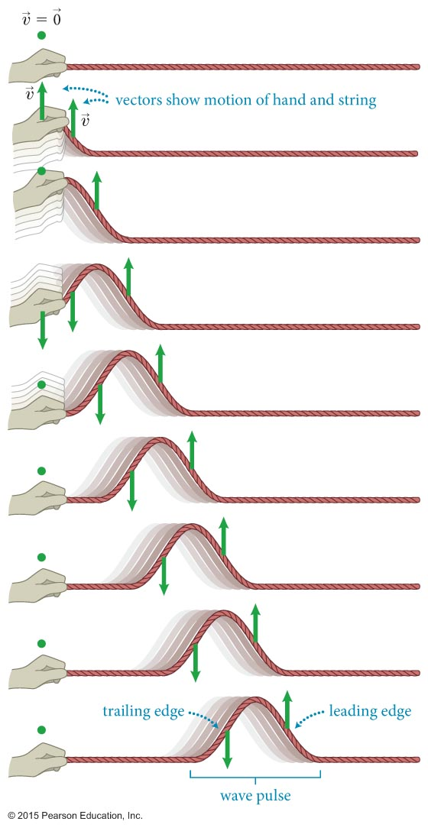
Section 16.1: Representing waves graphically
A transverse wave is a wave in which the medium movement is perpendicular to the wave pulse movement.
For example, a wave pulse travels along a string in a horizontal direction while the particles that make up the string move up and down.

Slide 5
Section 16.1: Representing waves graphically
The motion of a wave (or a single wave pulse) is distinct from the motion of the particles in the medium that transmits the wave (or pulse).
The wave speed c of a wave pulse along a string is constant.
http://resource.isvr.soton.ac.uk/spcg/tutorial/tutorial/Tutorial_files/Web-basics-nature.htm

Slide 6
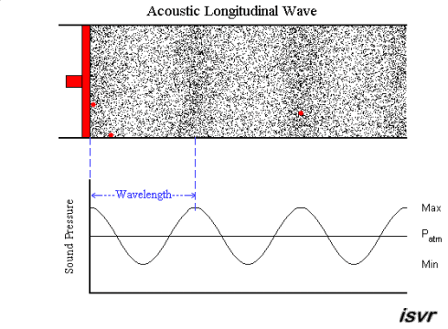
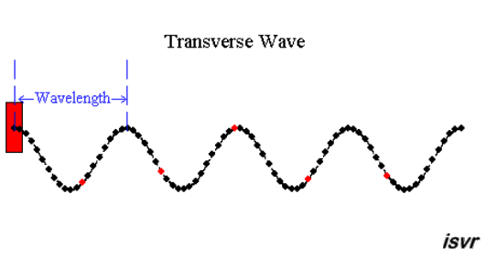
Section 16.1: Representing waves graphically
file:///Users/fraden/Downloads/wave-on-a-string_en.html

Slide 7
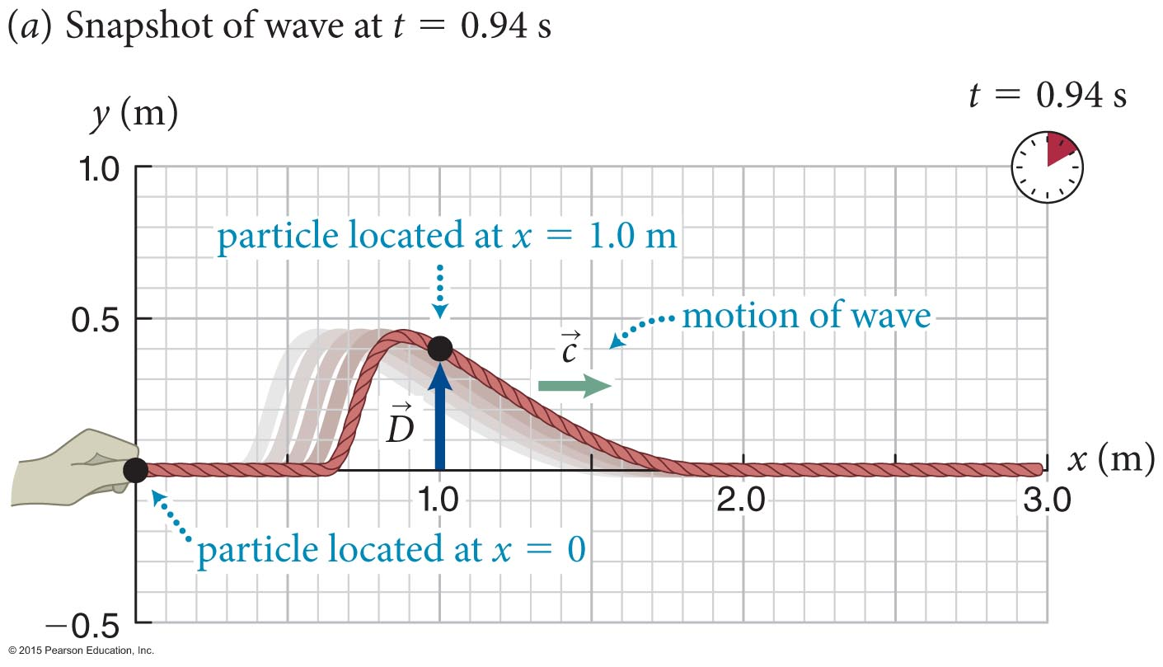
Section 16.1: Representing waves graphically
A “snapshot” of a triangular pulse traveling along a string.
The vector represents the displacement of one particular particle located at a position x along the string at a given instant t.

Slide 8
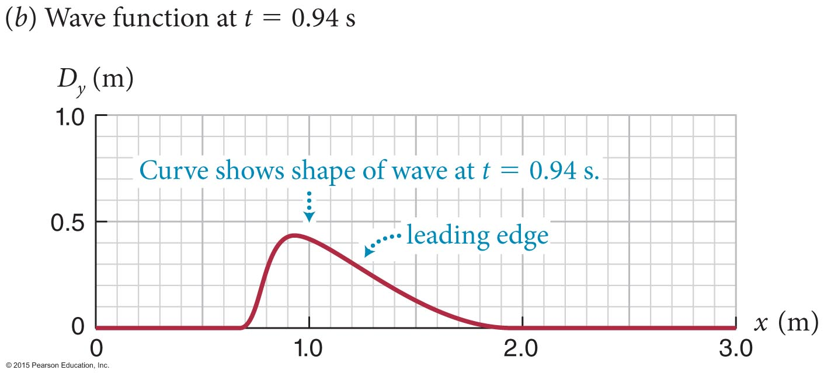
Section 16.1: Representing waves graphically
The wave function is the graphical representation of all the particle displacements at a given instant.
The wave function gives the y components of the displacements of the particles of the string as a function of the position x along the string.

Slide 9
Checkpoint 16.3
From Figure 16.4a, determine the displacement of a point (a) 1.0 m, (b) 1.5 m, and (c) 2.0 m from the end of the string. (d) On a snapshot taken a short time interval later, is the displacement at x = 1.5 m greater than, equal to, or smaller than that shown in Figure 16.4a?
From Figure 16.4a, determine the displacement of a point (a) 1.0 m, (b) 1.5 m, and (c) 2.0 m from the end of the string.
16.3

Slide 10
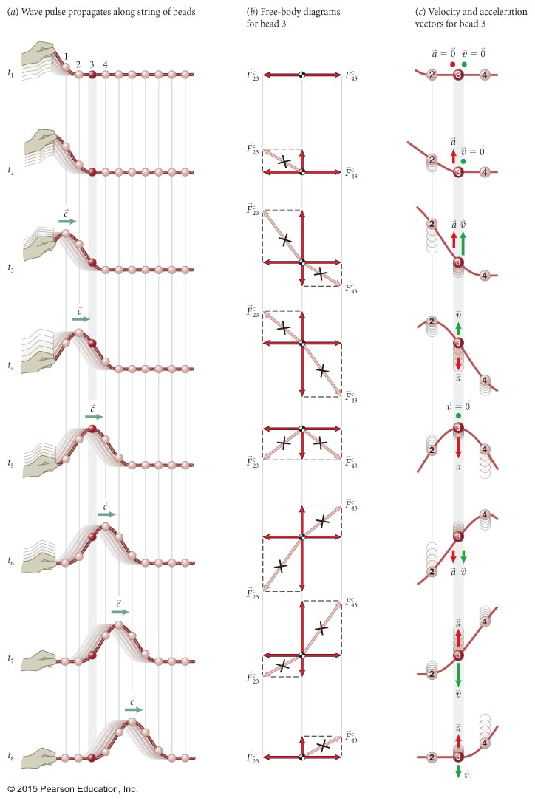
Section 16.2: Wave
propagation
Consider a collection of beads connected by short strings.
Displacement is transverse. What constraints does this place on the horizontal forces?

Slide 11
Checkpoint 16.6
Answer these five questions about the situation at t₁ in Figure 16.7, assuming the right end of the string of beads is attached to a wall that is not shown. (a) If what is the magnitude of the force exerted by the wall on the rightmost bead?
There is no horizontal acceleration, therefore all horizontal forces are in equilibrium so the force on the wall is 5N.
Notes:
5N

Slide 12
Checkpoint 16.6
Answer these five questions about the situation at t₁ in Figure 16.7, assuming the right end of the string of beads is attached to a wall that is not shown. (a) If what is the magnitude of the force exerted by the wall on the rightmost bead? (b) What is the magnitude of the horizontal component of
There is no horizontal acceleration, therefore all horizontal forces are in equilibrium so the force is 5N.
Notes:
5N

Slide 13
Checkpoint 16.6
Answer these five questions about the situation at t₁ in Figure 16.7, assuming the right end of the string of beads is attached to a wall that is not shown. (a) If what is the magnitude of the force exerted by the wall on the rightmost bead? (b) What is the magnitude of the horizontal component of (c) What is the direction of the force exerted by the hand on the string?
Up and left
Notes:
up and left

Slide 14
Checkpoint 16.6
Answer these five questions about the situation at t₁ in Figure 16.7, assuming the right end of the string of beads is attached to a wall that is not shown. (a) If what is the magnitude of the force exerted by the wall on the rightmost bead? (b) What is the magnitude of the horizontal component of (c) What is the direction of the force exerted by the hand on the string? (d) How does the magnitude of this force compare with the magnitude
Greater
Notes:
greater

Slide 15
Checkpoint 16.6
Answer these five questions about the situation at t₁ in Figure 16.7, assuming the right end of the string of beads is attached to a wall that is not shown. (a) If what is the magnitude of the force exerted by the wall on the rightmost bead? (b) What is the magnitude of the horizontal component of (c) What is the direction of the force exerted by the hand on the string? (d) How does the magnitude of this force compare with the magnitude (e) What are the effects of the horizontal and vertical components of this force?
Causes the beads to move up
Notes:
cause the beads to move up

Slide 16
Checkpoint 16.7
(a) Note that the displacement of bead 4 at t₄ in Figure 16.7a is the same as that of bead 3 at t₃. How do the velocity and acceleration of bead 4 at t₄ compare with those of bead 3 at t₃?
The pulse preserves shape as it propagates. Thus each bead has the same velocity and same acceleration at the same vertical displacement. The displacement of bead 4 at t₄ is the same as that of bead 3 at t₃, therefore their velocities and accelerations are equal.
Notes:
they are the same

Slide 17
Checkpoint 16.7
(b) You move one end of two different strings, A and B, up and down in the same way. Suppose the resulting pulse travels twice as fast on string A as on string B. How does the velocity of a particle of string A compare with the velocity of a particle of string B that has the same nonzero displacement?
The pulse preserves shape as it propagates. Thus each bead has the same velocity and same acceleration at the same vertical displacement. Since the first bead has to follow the hand, the shape of the pulse is set entirely by the motion of the hand. The transverse velocity and acceleration of the beads are independent of the speed of the pulse.
Notes:
vertical velocities the same for each string. Wave speed is different.

Slide 18
Checkpoint 16.7
(b) You move one end of two different strings, A and B, up and down in the same way. Suppose the resulting pulse travels twice as fast on string A as on string B. How does the velocity of a particle of string A compare with the velocity of a particle of string B that has the same nonzero displacement? (c) Sketch the pulses as they propagate along the two strings and point out any differences between the two.
t: elapsed time
τ: pulse duration

Slide 19
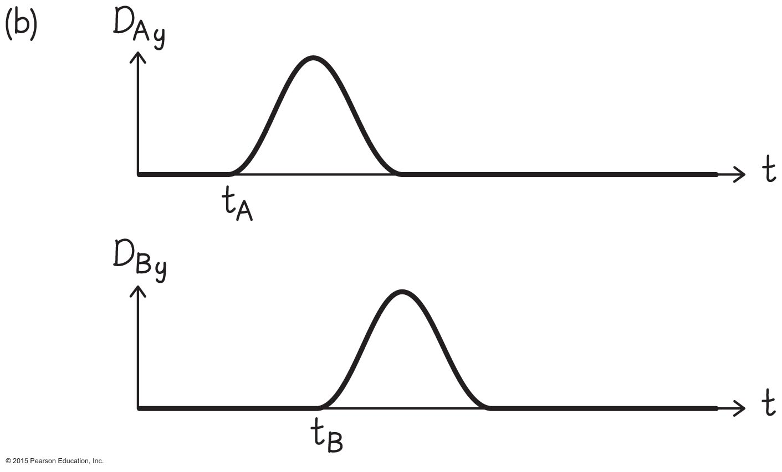
Checkpoint 16.7
(b) You move one end of two different strings, A and B, up and down in the same way. Suppose the resulting pulse travels twice as fast on string A as on string B. How does the velocity of a particle of string A compare with the velocity of a particle of string B that has the same nonzero displacement? (c) Sketch the pulses as they propagate along the two strings and point out any differences between the two. (d) For each string, consider a particle located 0.20 m from the left end. Sketch a displacement-versus-time graph for each particle, and point out any differences between your two graphs.
Duration of pulse is the same, because the same hand created the two pulses!

Slide 20
Chapter 16 Waves in One Dimension

Slide 21
Section 16.1: Representing waves graphically
file:///Users/fraden/Downloads/wave-on-a-string_en.html

Slide 22
Section 16.2: Wave propagation
When a particle of the string is displaced from its equilibrium position, its velocity and acceleration are determined only by the initial disturbance and are independent of the wave speed c.
For a given disturbance, high wave speeds yield wave pulses that are stretched out and low wave speeds result in pulses that are more compressed.

Slide 23
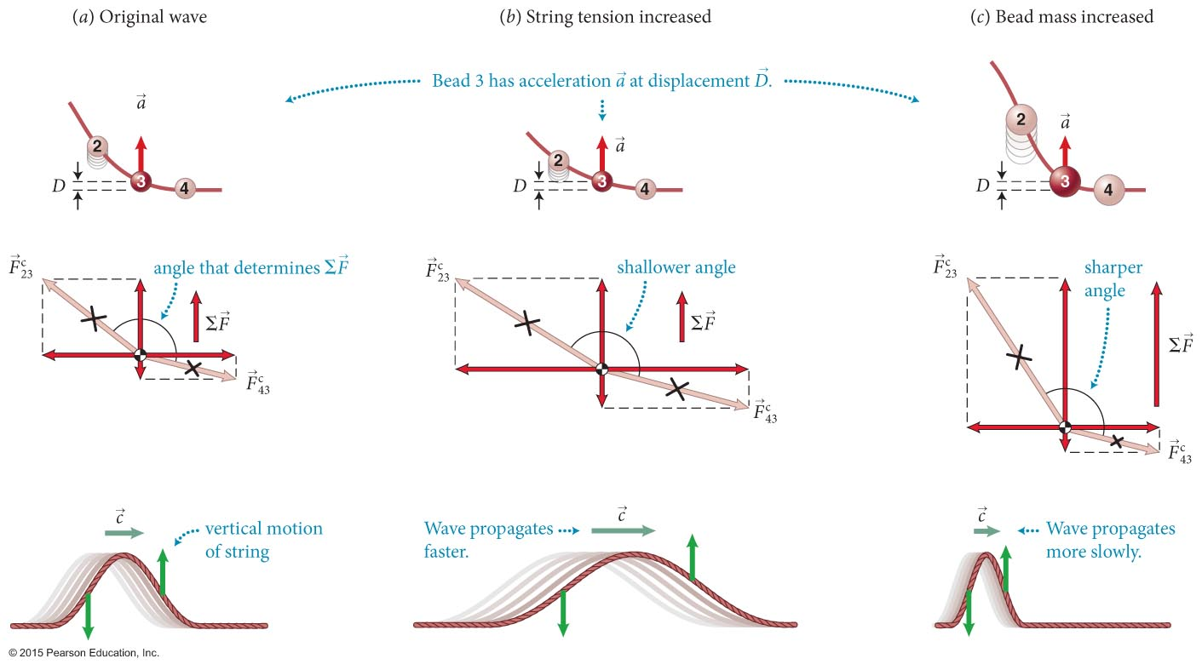
Section 16.2: Wave propagation
Consider the same waveform for 3 cases. The velocities and accelerations are the same for the same displacement.
The speed c of a wave propagating along a string increases with increasing tension in the string and decreases with increasing mass per unit length along the string.

Slide 24
Checkpoint 16.8
Two strings, A and B, are identical except that the tension in A is greater than that in B. Suppose you move the left end of each string rapidly up and down once. For each string, sketch (a) the wave functions at the instant the pulse on A has traveled halfway down the length of the string and (b) the displacement curve for a particle midway down the string.
16.8

Slide 25
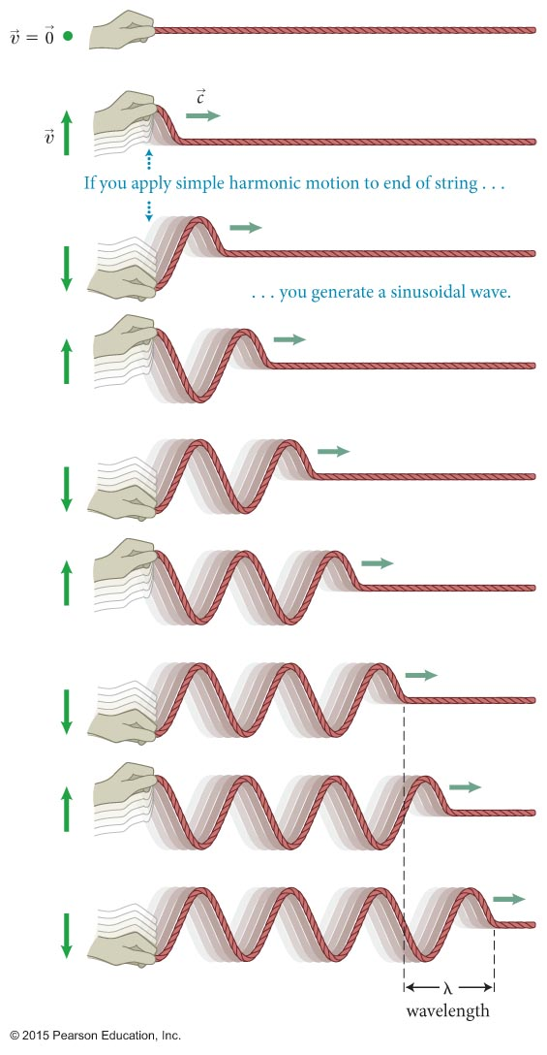
Section 16.2: Wave propagation
If one end of a string is made to execute a periodic motion, the resulting wave is called a periodic wave.
A harmonic wave, shown in the figure, is a type of periodic wave obtained by moving the end of the string so that it oscillates harmonically.
file:///Users/fraden/Downloads/wave-on-a-string_en.html

Slide 26
Section 16.2: Wave propagation
A periodic wave repeats itself over a distance called the wavelength, denoted by λ.
Each time, τ, one point on the string executes a complete oscillation, the wave advances by one wavelength.
The wavelength of a periodic wave is equal to the product of the wave speed and the period of the wave motion.
file:///Users/fraden/Downloads/wave-on-a-string_en.html

Slide 27
Chapter 16 Waves in One Dimension

Slide 28
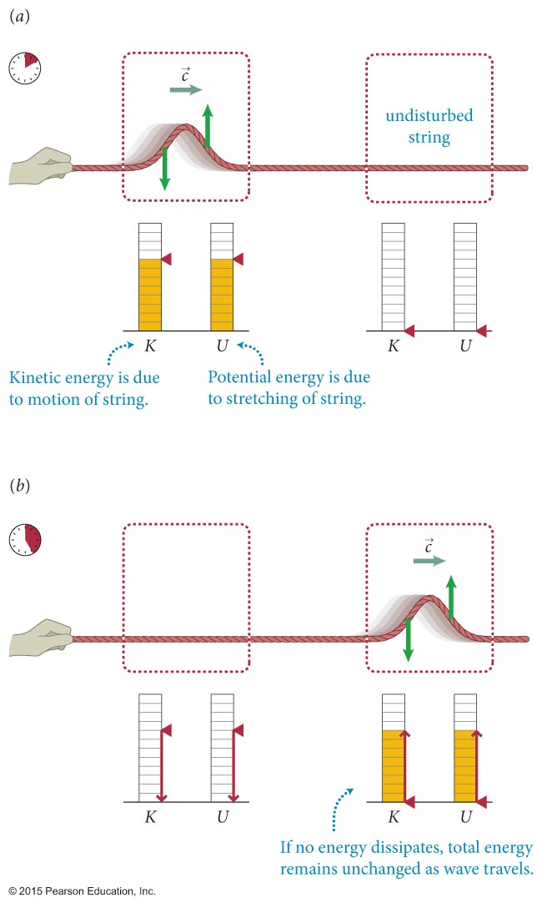
Section 16.2: Wave propagation
A propagating wave pulse caries two forms of energy along with it:
Kinetic energy associated with individual particles
Elastic potential energy associated with the stretching of the string
file:///Users/fraden/Downloads/wave-on-a-string_en.html

Slide 29
Checkpoint 16.11
Does the wave pulse in Figure 16.11 also carry along momentum? Justify your answer.
16.11
Yes. Imagine a ball sitting on top of the string. When the pulse passes under the ball, it delivers an impulse and transfers transverse momentum to the ball.

Slide 30
Section 16.5: Wave functions
D_{y} is the displacement of any particle on the string measured in Earth’s reference frame.
We can write D_{y} = f(x, t), where f(x, t) is called the time-dependent wave function.
f(x, t) completely specifies the changing shape of the wave as seen from Earth’s reference frame.
We can show that for a wave propagating at speed c: D_{y} = f(x – ct)
The center of the pulse is located at f(0) determined by x – ct = 0
x(t) = ct

Slide 31
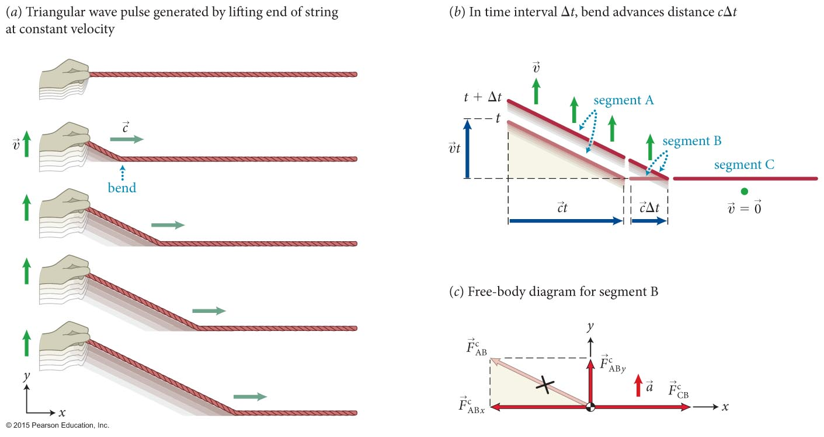
Section 16.7: Wave speed
Create triangular wave pulse by lifting end of string at constant velocity v

Slide 32
Section 16.7: Wave speed
Apply 2nd Law to segment B
Similar triangles
Wave speed

Slide 33
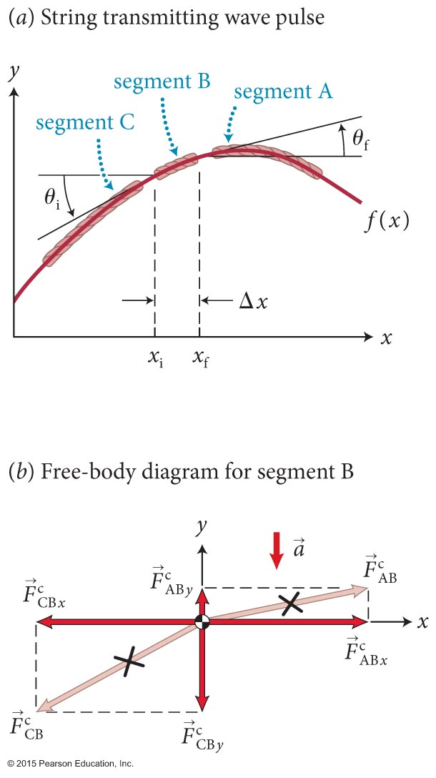
Section 16.9: The wave equation

Slide 34
Section 16.9: The wave equation

Slide 35
Section 16.9: The wave equation

Slide 36
Section 16.9: The wave equation

Slide 37
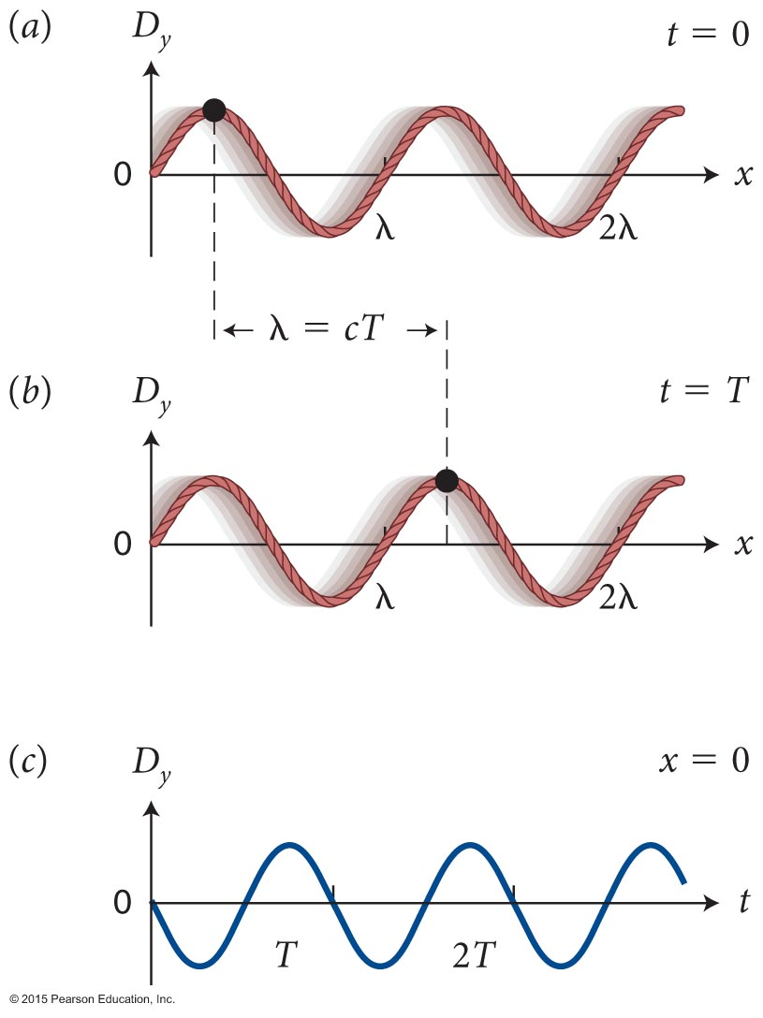
Section 16.5: Wave functions
file:///Users/fraden/Downloads/wave-on-a-string_en.html
Let us consider a transverse harmonic wave traveling along a string.
We can see from part (b) that during a time interval of one period, the wave advances by a wavelength.
Because the wave moves at a speed c, and f ≡ 1/T, we get
λf = c
ω = 2πf = 2π/T

Slide 38
Exercise 16.6 Sinusoidal solution to the wave equation
Section 16.9: The wave equation
Show that a sinusoidal traveling wave of the form f (x, t) = A sin(kx – ωt) satisfies the wave equation for any value of k and ω.
c = ω/k

Slide 39
Exercise 16.6 Sinusoidal solution to the wave
Section 16.9: The wave equation
f (x, t) = A sin(kx – ωt)
Solution The first partial derivative of f (x, t) with respect to x is
and so the second partial derivative with respect to x is
(1)

Slide 40
Exercise 16.6 Sinusoidal solution to the wave equation (cont.)
Section 16.9: The wave equation
f (x, t) = A sin(kx – ωt)
The first partial derivative of f (x, t) with respect to t is
Differentiating again gives

Slide 41
Exercise 16.6 Sinusoidal solution to the wave equation
Section 16.9: The wave equation
Multiplying both sides of this equation by 1/c² and using k = ω/c (Eq. 16.11), I obtain
Because the right sides of Eqs. 1 and 2 are equal, the left sides must also be equal, so
which is Eq. 16.51, and so the wave equation is satisfied. ✔
(2)
f (x, t) = A sin(kx – ωt)

Slide 42
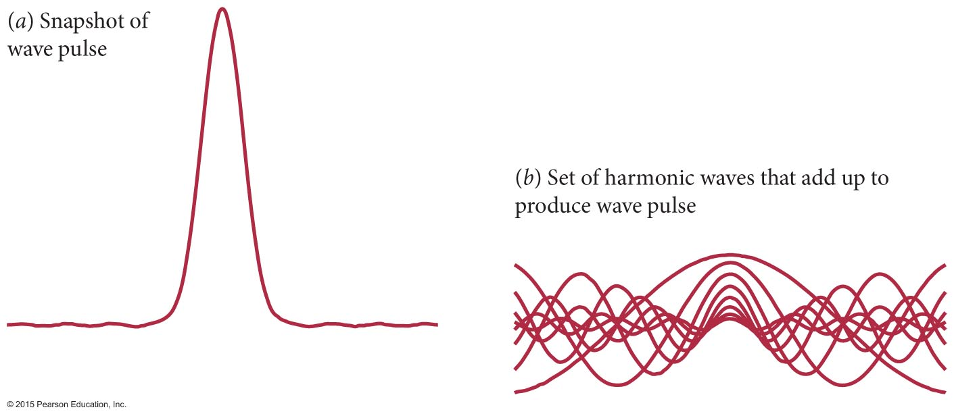
Section 16.5: Wave functions
Fourier’s theorem from Section 15.3 can be applied to waves.
Any wave can be expressed in terms of sinusoidally varying waves.
The figure shows a wave pulse obtained by adding together a set of harmonic waves.
Mathematica

Slide 43
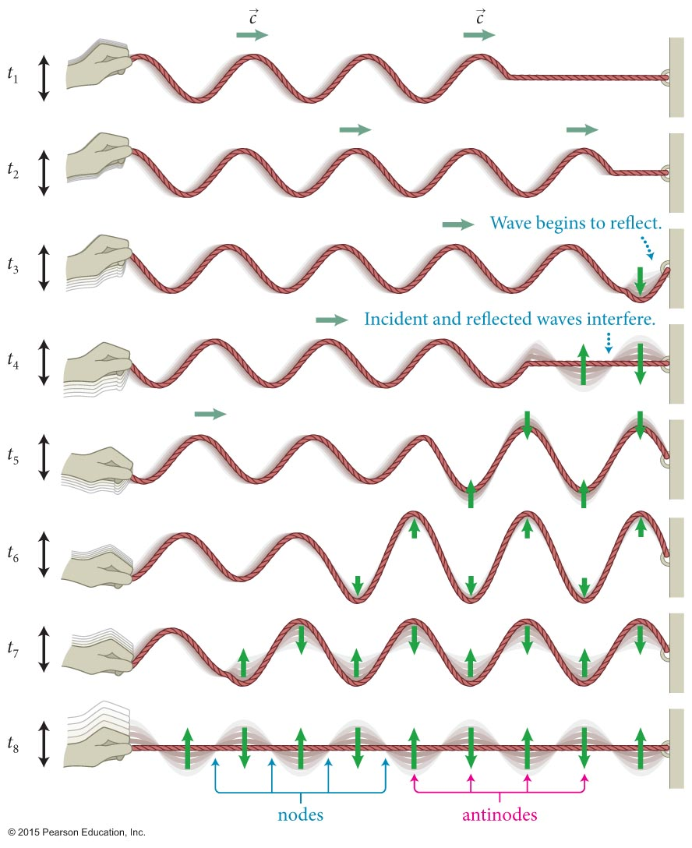
Section 16.6: Standing waves
The figure shows the interference between a incident harmonic wave on a string and the reflected wave from the fixed end of the string.
The points on the string that have zero displacement are called nodes.
Halfway between the nodes are the antinodes where the particles in the medium oscillate with maximum displacement.

Slide 44
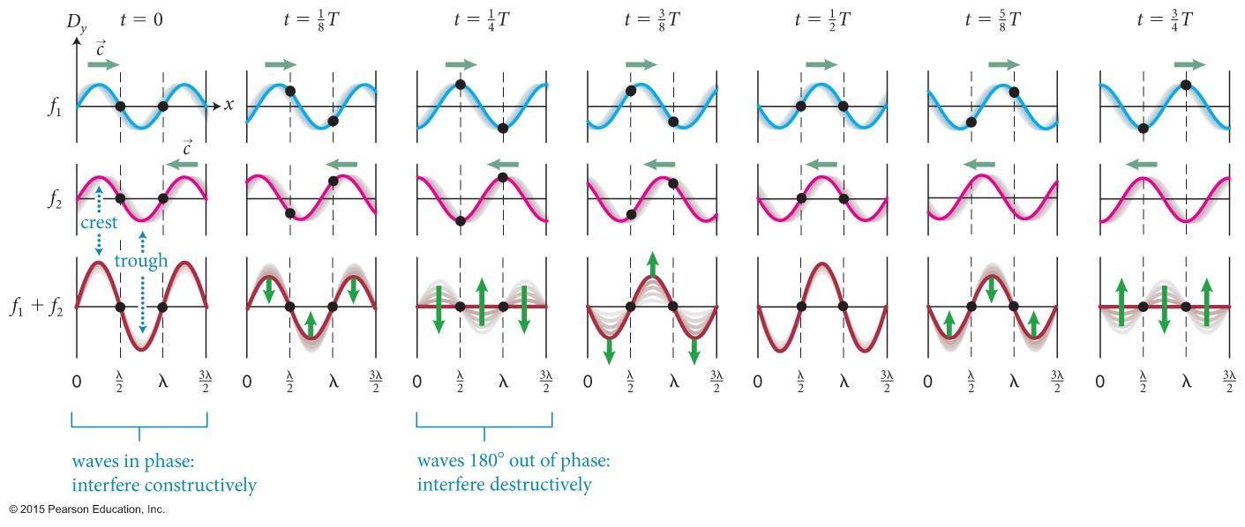
Section 16.6: Standing waves
The pulsating stationary pattern caused by harmonic waves of the same amplitude traveling in opposite direction is called a standing wave.
The figure illustrates how standing waves come about.

Slide 45
Section 16.6: Standing waves
A sinusoidal wave traveling to the right along the x-axis with angular frequency ω, wave number k, and amplitude A is
D_{1y} = f₁(x, t) = A sin(kx - ωt)
The wave traveling to the left is
D_{2y} = f₂(x, t) = A sin(kx + ωt)
The combined wave is
D_{y} = f₁(x, t) + f₂(x, t) = A[sin(kx - ωt) + sin(kx + ωt)]
By simplifying this using trigonometric identities, we get
D_{y} = f₁(x, t) + f₂(x, t) = 2A sin kx cos ωt = [2A sin kx] cos ωt

Slide 46
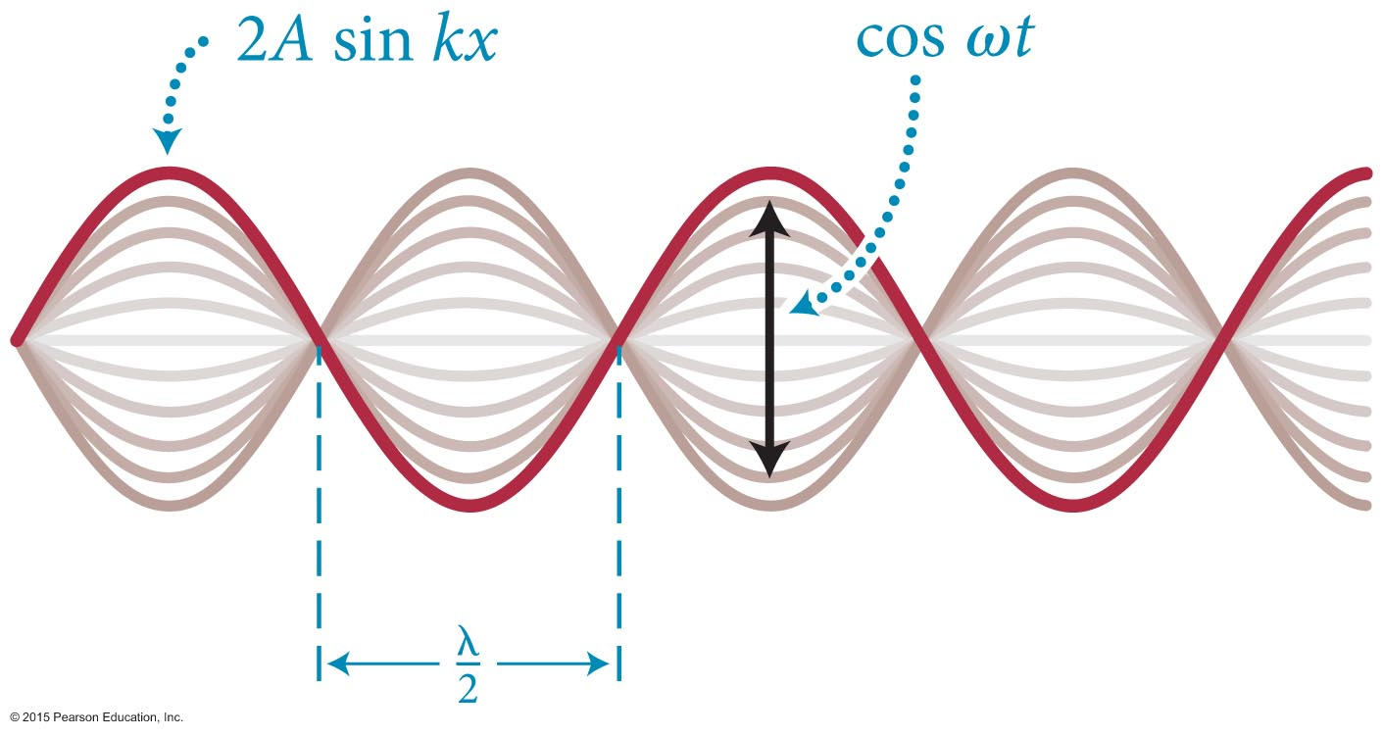
Section 16.6: Standing waves
At points that are nodes in a standing wave sin kx must be zero.
Therefore, at these points kx = nπ, where n is a whole number.
Using the definition of k = 2π/λ, we obtain
So, the nodes occur at
file:///Users/fraden/Downloads/wave-on-a-string_en.html

Slide 47
Section 16.6: Standing waves
Antinodes occur when sin kx = ±1.
This requires that kx = n(π/2), where n is an odd whole number.
So, the antinodes occur at

Slide 48
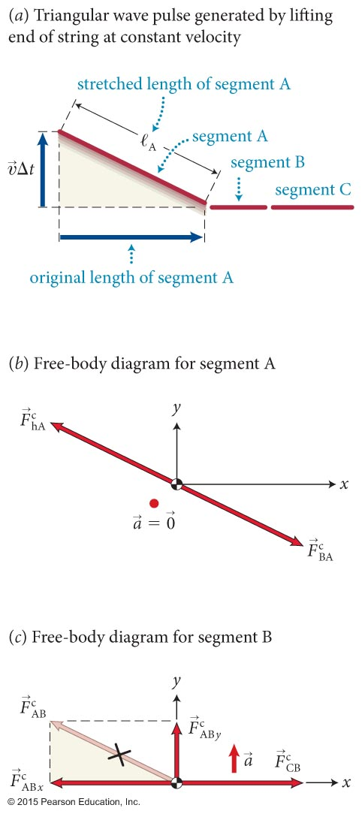
Section 16.8: Energy transport in waves
Let E_{λ} denote the energy that must be supplied over a period T to generate a wave on a string.
Then the average power that must be supplied to generate the wave is given by
Using the figure, we can show
And the average power is

Slide 49
Concepts: Representing waves
Chapter 16: Summary
A wave is a disturbance that propagates through material (the medium) or through empty space.
A wave pulse is a single isolated propagating disturbance.
The wave function represents the shape of a wave at any given instant and changes with time as the wave travels.

Slide 50
Concepts: Representing waves
Chapter 16: Summary
The wave speed c is the speed at which a wave propagates. For a mechanical wave, c is different from the speed υ of the particles of the medium and is determined by the properties of the medium.
The displacement of any particle of a medium through which a mechanical wave travels is a vector that points from the equilibrium position of the particle to its actual position.

Slide 51
Concepts: Representing waves
Chapter 16: Summary
In a transverse mechanical wave, the particles of the medium move perpendicular to the direction of the pulse movement.
In a longitudinal mechanical wave, these particles move parallel to the direction of the pulse movement.
In a periodic wave, the displacement at any location in the medium is a periodic function of time. A periodic wave is harmonic when the particle displacement can be represented by a sinusoidally varying function of space and time.

Slide 52
Quantitative Tools: Representing waves
Chapter 16: Summary
If a wave travels in the x direction with speed c and f (x) describes the form (shape) of the wave, then the y component D_{y} of the displacement of a particle of the medium is
D_{y} = f (x – ct)
if the wave travels in the positive x direction and
D_{y} = f (x + ct)
if the wave travels in the negative x direction.
The wavelength λ of a periodic wave is the minimum distance over which the wave repeats itself.

Slide 53
Quantitative Tools: Representing waves
Chapter 16: Summary
For a periodic wave of period T, frequency f, and speed c, the wave number k is
The wavelength λ is
λ = cT,
The angular frequency ω is
The wave speed is
c = λf.

Slide 54
Quantitative Tools: Representing waves
Chapter 16: Summary
For a transverse harmonic wave of amplitude A and initial phase ϕ_{i} traveling in the positive x direction, the y component D_{y} of the displacement of a particle of the medium is
D_{y} = f (x, t) = A sin(kx – ωt + ϕ_{i}).

Slide 55
Concepts: Combining waves
Chapter 16: Summary
Superposition of waves: The resultant displacement of two or more overlapping waves is the algebraic sum of the displacements of the individual waves.
Interference occurs when two waves overlap. The interference is constructive when the displacements due to the two waves are in the same direction and destructive when the displacements are in opposite directions.
If the displacement at a point in space remains zero as a wave travels through, that point is a node. The displacement at other points typically varies with time. If the displacement at a point in space varies over the greatest range as a wave travels through, that point is an antinode.

Slide 56
Concepts: Combining waves
Chapter 16: Summary
When a wave pulse (the incident wave) reaches a boundary where the transmitting medium ends, the pulse is reflected, which means it reverses its direction.
When a wave pulse is reflected from a fixed boundary, the reflected pulse is inverted relative to the incident pulse. When the reflection is from a boundary that is free to move, the reflected pulse is not inverted.
A standing wave is a pulsating stationary pattern caused by the interference of harmonic waves of equal amplitude and wavelengths traveling in opposite directions.

Slide 57
Quantitative Tools: Combining waves
Chapter 16: Summary
If two harmonic waves of equal wavelength λ and equal amplitude A travel in opposite directions on a string, they produce a standing wave. The y component D_{y} of the string displacement at any position x along the string is given by
D_{y} = 2A sin kx cos ωt.
The nodes occur at
The antinodes occur at

Slide 58
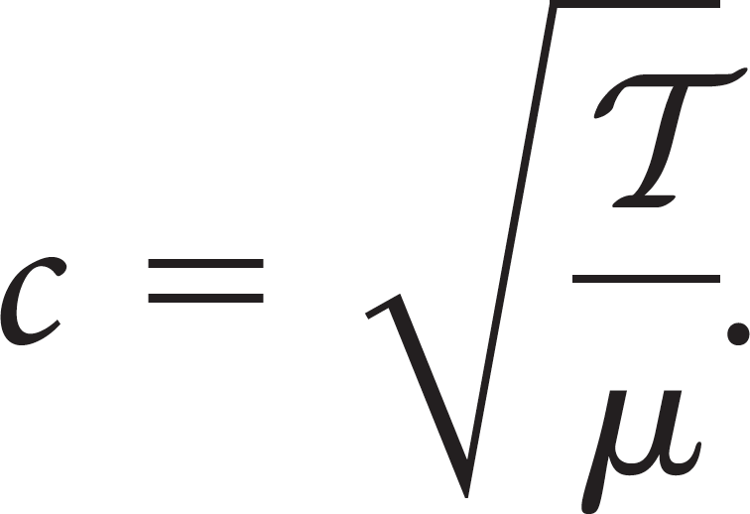
Quantitative Tools: Waves on a string
Chapter 16: Summary
For a uniform string of mass m and length ℓ, the linear mass density μ (mass per unit length) is
The speed of a wave on a string under tension is

Slide 59
Quantitative Tools: Waves on a string
Chapter 16: Summary
The average power P_{av} that must be supplied to generate a wave of period T is
Any function f of the form f (x – ct) or f (x + ct) that represents a wave traveling with speed c is a solution of the wave equation:

